Slide 1
Scenario
Name: Md Shariful Islam
ID: 011151243
Name: Anika Jahin
ID: 011151251

Slide 2
Project Description
It is a scenario based project. It has some static elements & also some dynamic actions like car movement, cloud movement.

Slide 3
Contribution
Anika Jahin
Md Shariful Islam
Cloud, tree, sun, stars making
Day & night occurrence
Cloud movement
Cars, house, moon making
Cars movement & action

Slide 4
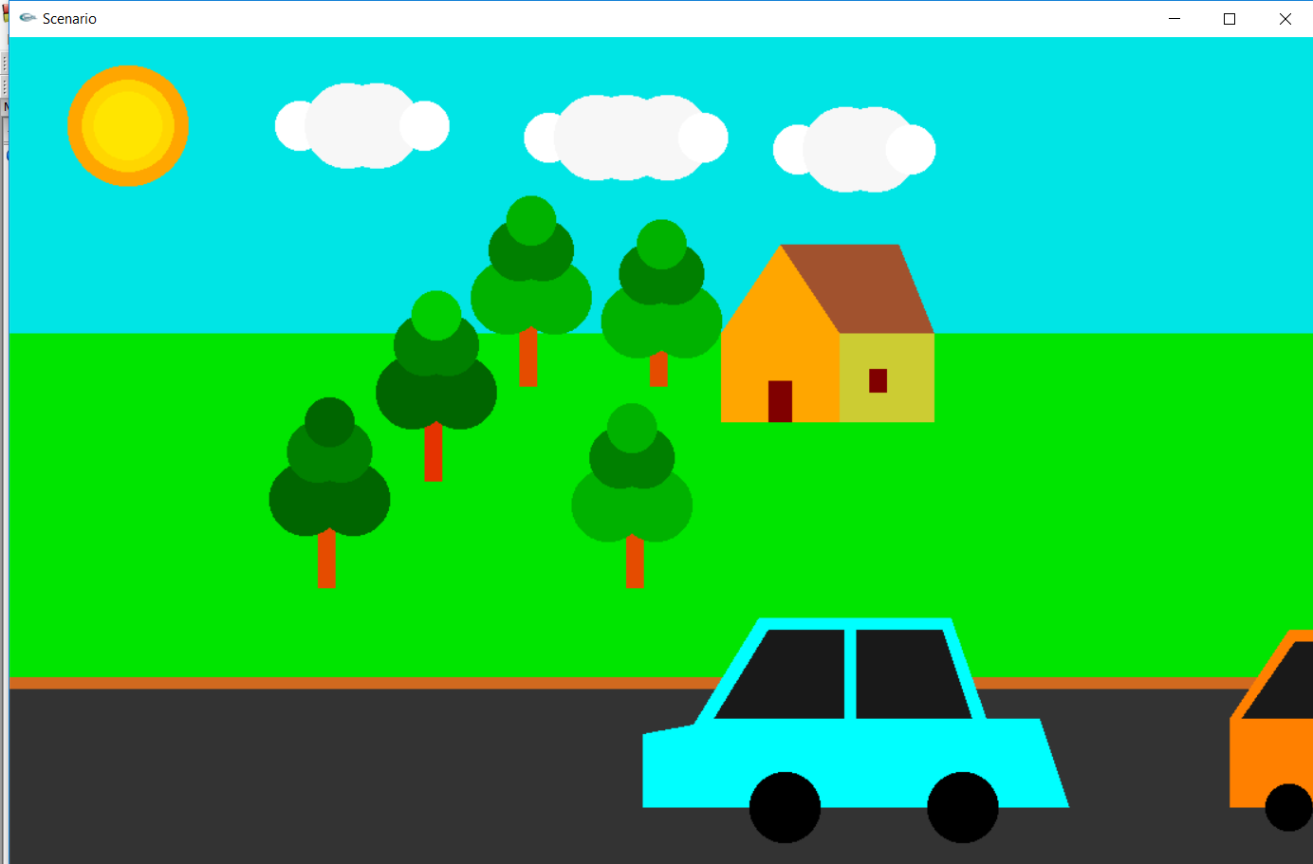
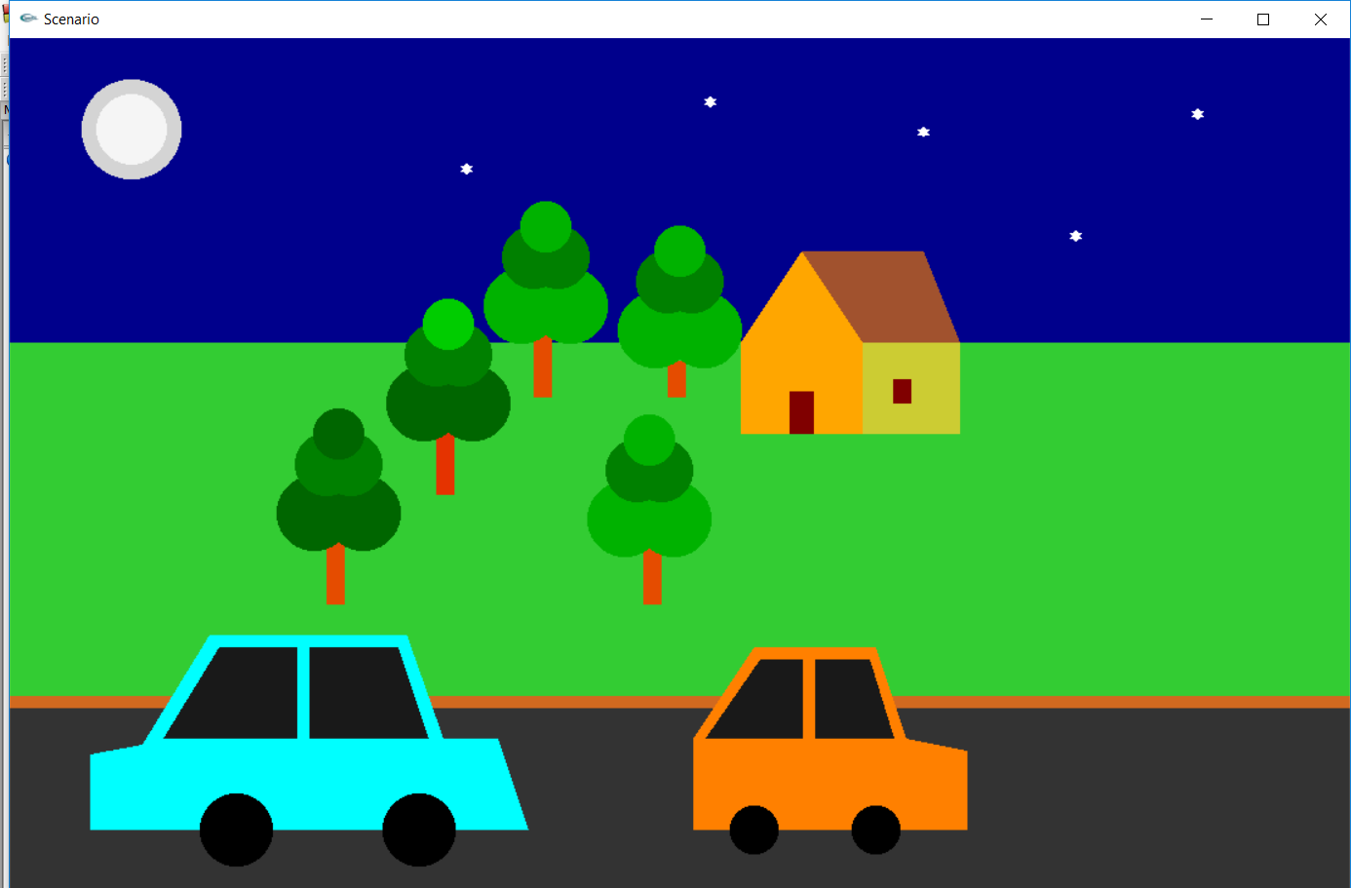
Screenshots

Slide 5
THANK YOU

